Slide 1
Authorization
This lecture slide is mainly based on the power point slides by Professor Mark Stamp.
CS7900, Meilin Liu

Slide 2
Authentication vs Authorization
Authentication ⎯ Are you who you say you are?
  Restrictions on who (or what) can access system
Authorization ⎯ Are you allowed to do that?
  Restrictions on actions of authenticated users
Authorization is a form of access control
But first, we look at system certification…
CS7900, Meilin Liu

Slide 3
Authentication vs Authorization
Authentication ⎯ Are you who you say you are?
  Restrictions on who (or what) can access system
Authorization ⎯ Are you allowed to do that?
  Restrictions on actions of authenticated users
Authorization is a form of access control
Classic authorization enforced by
  Access Control Lists (ACLs)
  Capabilities (C-lists)
CS7900, Meilin Liu

Slide 4
Lampson’s Access Control Matrix
Subjects (users) index the rows
Objects (resources) index the columns
Accounting
program
Accounting
data
Insurance
data
Payroll
data
OS
rx | rx | r | --- | ---
rx | rx | r | rw | rw
rwx | rwx | r | rw | rw
rx | rx | rw | rw | rw
Bob
Alice
Sam
Accounting
program
CS7900, Meilin Liu

Slide 5
Are You Allowed to Do That?
Access control matrix has all relevant info
Could be 1000’s of users, 1000’s of resources
Then matrix with 1,000,000’s of entries
How to manage such a large matrix?
Need to check this matrix before access to any resource is allowed
How to make this efficient?
CS7900, Meilin Liu

Slide 6
Access Control Lists (ACLs)
ACL: store access control matrix by column
Example: ACL for insurance data is in blue
Accounting
program
Accounting
data
Insurance
data
Payroll
data
OS
rx | rx | r | --- | ---
rx | rx | r | rw | rw
rwx | rwx | r | rw | rw
rx | rx | rw | rw | rw
Bob
Alice
Sam
Accounting
program
CS7900, Meilin Liu

Slide 7
Access Control Lists (ACLs)
ACL: store access control matrix by column
Example: ACL for insurance data is in blue
Insurance data:
(Bob, ---), (Alice, rw), (Sam, rw), (accounting program, rw)
CS7900, Meilin Liu

Slide 8
Capabilities (or C-Lists)
Store access control matrix by row
Example: Capability for Alice is in red
Alice: (OS, rx), (accounting program, rx), (accounting data, r),
(insurance data, rw), (payroll data, rw).
CS7900, Meilin Liu

Slide 9
Capabilities (or C-Lists)
Store access control matrix by row
Example: Capability for Alice is in red
Accounting
program
Accounting
data
Insurance
data
Payroll
data
OS
rx | rx | r | --- | ---
rx | rx | r | rw | rw
rwx | rwx | r | rw | rw
rx | rx | rw | rw | rw
Bob
Alice
Sam
Accounting
program
CS7900, Meilin Liu

Slide 10
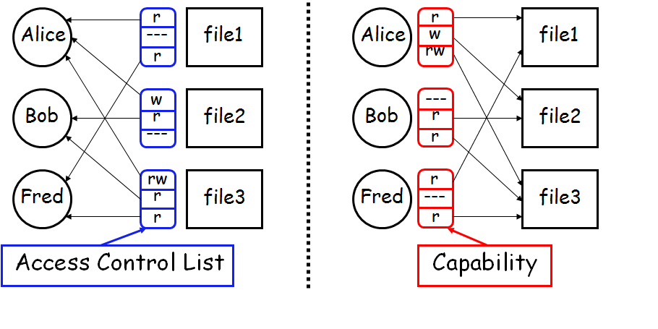
ACLs vs Capabilities
Note that arrows point in opposite directions…
With ACLs, still need to associate users to files
CS7900, Meilin Liu

Slide 11
Confused Deputy
Two resources
  Compiler and BILL file (billing info)
Compiler can write file BILL
Alice can invoke compiler with a debug filename
Alice not allowed to write to BILL
Access control matrix
Compiler
BILL
x | ---
rx | rw
Alice
Compiler
CS7900, Meilin Liu

Slide 12

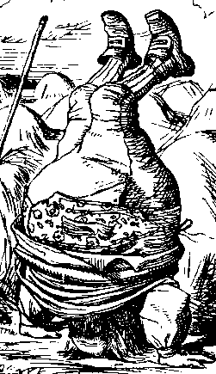

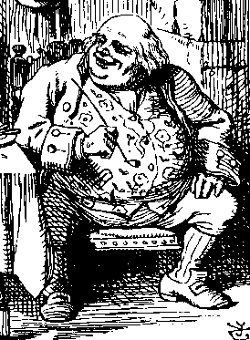
ACL’s and Confused Deputy
debug
BILL
filename BILL
Compiler
Alice
BILL
Compiler is deputy acting on behalf of Alice
Compiler is confused
  Alice is not allowed to write BILL
Compiler has confused its rights with Alice’s
CS7900, Meilin Liu

Slide 13
Confused Deputy
Compiler acting for Alice is confused
There has been a separation of authority from the purpose for which it is used
With ACLs, difficult to avoid this problem
With Capabilities, easier to prevent problem
  Must maintain association between authority and intended purpose
  Capabilities make it easy to delegate authority
CS7900, Meilin Liu

Slide 14
ACLs vs Capabilities
ACLs
  Good when users manage their own files
  Protection is data-oriented
  Easy to change rights to a resource
Capabilities
  Easy to delegate---avoid the confused deputy
  Easy to add/delete users
  More difficult to implement
  The “Zen of information security”
Capabilities loved by academics
  Capability Myths Demolished
CS7900, Meilin Liu

Slide 15
Multilevel Security (MLS) Models
CS7900, Meilin Liu

Slide 16
Classifications and Clearances
Classifications apply to objects
Clearances apply to subjects
US Department of Defense (DoD) uses 4 levels:
  TOP SECRET
  SECRET
  CONFIDENTIAL
  UNCLASSIFIED
CS7900, Meilin Liu

Slide 17
Clearances and Classification
To obtain a SECRET clearance requires a routine background check
A TOP SECRET clearance requires extensive background check
Practical classification problems
  Proper classification not always clear
  Level of granularity to apply classifications
  Aggregation ⎯ flipside of granularity
CS7900, Meilin Liu

Slide 18
Subjects and Objects
Let O be an object, S a subject
  O has a classification
  S has a clearance
  Security level denoted L(O) and L(S)
For DoD levels, we have
TOP SECRET > SECRET >
CONFIDENTIAL > UNCLASSIFIED
CS7900, Meilin Liu

Slide 19
Multilevel Security (MLS)
MLS needed when subjects/objects at different levels use/on same system
MLS is a form of Access Control
Military and government interest in MLS for many decades
  Lots of research into MLS
  Strengths and weaknesses of MLS well understood (almost entirely theoretical)
  Many possible uses of MLS outside military
CS7900, Meilin Liu

Slide 20
MLS Applications
Classified government/military systems
Business example: info restricted to
  Senior management only, all management, everyone in company, or general public
Network firewall
Confidential medical info, databases, etc.
Usually, MLS not a viable technical system
  More of a legal device than technical system
CS7900, Meilin Liu

Slide 21
MLS Security Models
MLS models explain what needs to be done
Models do not tell you how to implement
Models are descriptive, not prescriptive
  That is, high level description, not an algorithm
There are many MLS models
We’ll discuss simplest MLS model
  Other models are more realistic
  Other models also more complex, more difficult to enforce, harder to verify, etc.
CS7900, Meilin Liu

Slide 22
Bell-LaPadula
BLP security model designed to express essential requirements for MLS
BLP deals with confidentiality
  To prevent unauthorized reading
Recall that O is an object, S a subject
  Object O has a classification
  Subject S has a clearance
  Security level denoted L(O) and L(S)
CS7900, Meilin Liu

Slide 23
Bell-LaPadula
BLP consists of
  Simple Security Condition: S can read O if and only if L(O) ≤ L(S)
  *-Property (Star Property): S can write O if and only if L(S) ≤ L(O)
No read up, no write down
CS7900, Meilin Liu

Slide 24
McLean’s Criticisms of BLP
McLean: BLP is “so trivial that it is hard to imagine a realistic security model for which it does not hold”
McLean’s “system Z” allowed administrator to reclassify object, then “write down”
Is this fair?
Violates spirit of BLP, but not expressly forbidden in statement of BLP
Raises fundamental questions about the nature of (and limits of) modeling
CS7900, Meilin Liu

Slide 25
B and LP’s Response
BLP enhanced with tranquility property
  Strong tranquility: security labels never change
  Weak tranquility: security label can only change if it does not violate “established security policy”
Strong tranquility impractical in real world
  Often want to enforce “least privilege”
  Give users lowest privilege for current work
  Then upgrade as needed (and allowed by policy)
  This is known as the high water mark principle
Weak tranquility allows for least privilege (high water mark), but the property is vague
CS7900, Meilin Liu

Slide 26
BLP: The Bottom Line
BLP is simple, probably too simple
BLP is one of the few security models that can be used to prove things about systems
BLP has inspired other security models
  Most other models try to be more realistic
  Other security models are more complex
  Models difficult to analyze, apply in practice
CS7900, Meilin Liu

Slide 27
Biba’s Model
BLP for confidentiality, Biba for integrity
  Biba is to prevent unauthorized writing
Biba is (in a sense) the dual of BLP
Integrity model
  Suppose you trust the integrity of O1 but not O2
  If object O includes O1 and O2 then you cannot trust the integrity of O
Integrity level of O is minimum of the integrity of any object in O
Low water mark principle for integrity
CS7900, Meilin Liu

Slide 28
Biba
Let I(O) denote the integrity of object O and I(S) denote the integrity of subject S
Biba can be stated as
  Write Access Rule: S can write O if and only if I(O) ≤ I(S)
  (if S writes O, the integrity of O ≤ that of S)
  Biba’s Model: S can read O if and only if I(S) ≤ I(O)
  (if S reads O, the integrity of S ≤ that of O)
Often, replace Biba’s Model with
  Low Water Mark Policy: If S reads O, then I(S) = min(I(S), I(O))
CS7900, Meilin Liu

Slide 29
BLP vs Biba
BLP
Biba
high
high
l
e
v
e
l
L(O)
L(O)
I(O)
l
e
v
e
l
L(O)
I(O)
I(O)
low
Confidentiality
Integrity
low
CS7900, Meilin Liu

